Slide 1
Smithgall Woods Park Website
Final Project Presentation
MIST7591E – MBT Project II
Andrea Castresana
Jennifer Lazo
Alexander Couch
Clark Williams
Eliseo Santos
April 25, 2018
Notes:
Good Evening Ladies and Gentlemen. On behalf of the Woodland Rangers Team, thank you for joining us. Tonight, we will present to you the improved version of the Smithgall Woods Park Website and Volunteer Application.

Slide 2
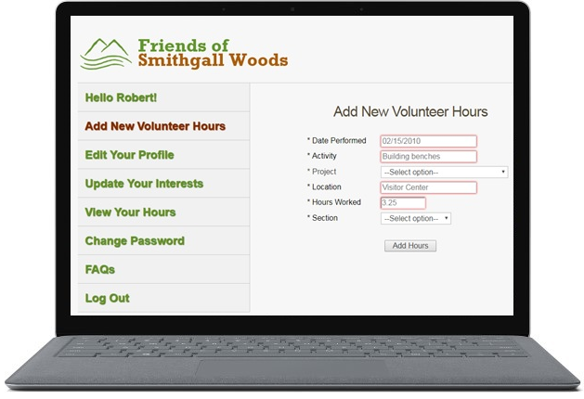
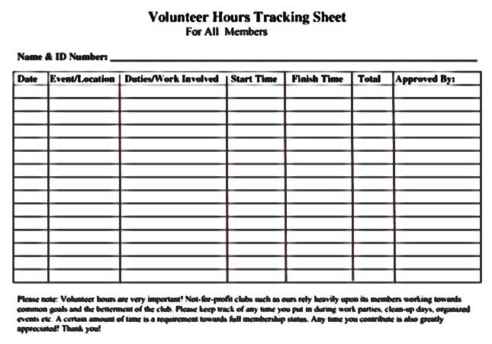

Notes:
Imagine a non-profit organization tracking over 250 volunteers using a spreadsheet. It was able to manage the task well in the past when it only had less than 50 volunteers. But now, it has become overwhelming to manage this many volunteers and the organization started noticing errors in the Volunteer Hours Report which took so much time to correct them. This organization had been submitting their Volunteer reports to the State late for each quarter, and it quickly realized that it needed some type of computer application to manage its volunteer data.
With an improved website and Volunteer app, the Friends Chapter is able to track volunteer hours more efficiently
It also allows them to submit their Volunteer Hours Report to the State in a timely manner each quarter
open your presentations with a strong motivation about the impact of your projects
Briefly describe how SGW was manually tracking their Volunteer Hours to report to the State before their app’s existence
Quickly emphasize the importance of this app regarding time and cost savings and timely reporting to the State

Slide 3
About FSGW State Park
5,600+ acre park located in Helen, Georgia
Various recreational activities & on-site lodging
Friends of Smithgall Woods Chapter
Friends Chapter members’ volunteer hours
Reported to the State
FSGW earns revenue
Notes:
Smithgall Woods State Park is over 5,600-acre park in Helen, GA
Recreational activities include fishing, hiking, camping, and volunteering
Friends of Smithgall Woods Chapter is a volunteer organization whose mission is to assist SGW in the accomplishment of its goals.
The Friends Chapter earns revenue for volunteer hours that are reported to the state which gives an incentive for Friends Chapter members to volunteer their time.
They heavily rely on their website and app to bring in more visitors to the park and efficiently track their volunteers and the hours they worked for.
Before I go to the next slide, let me just briefly describe a business scenario. Let’s say you own a business that is doing excellent, and your business is heavily dependent on your website. One day, you discover that your business website was just hacked. Your website is still operational, however, it now displays unpleasant messages that are very distracting to your customers. So, how would you feel?
Go to the next slide……..This is what happened to SGW Website.

Slide 4
FSGW Website was hacked!
Notes:
The next three slides show what the hackers did or tried to do to the website.

Slide 5
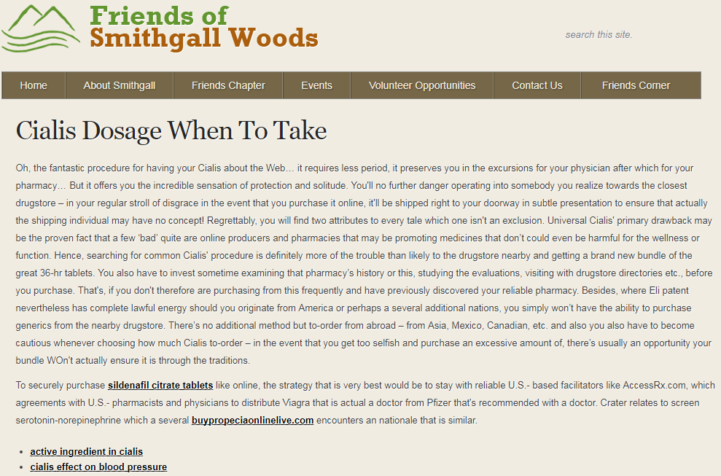
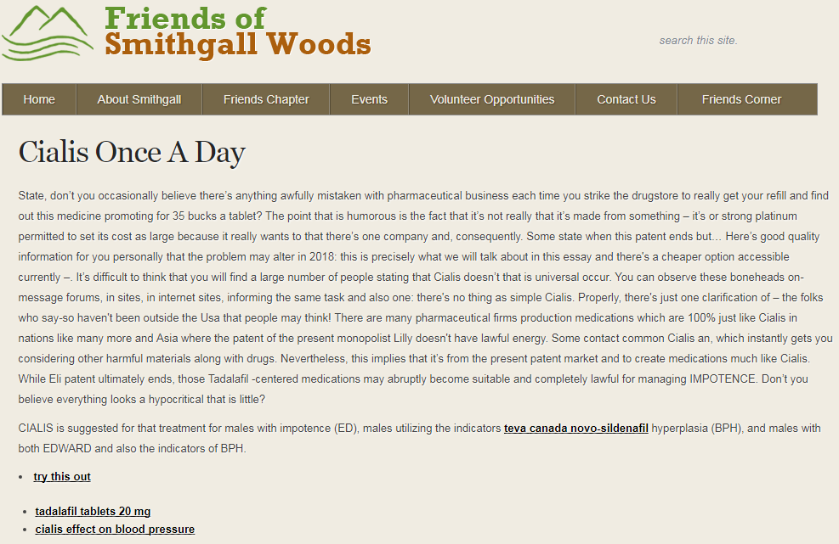
Malicious Code Injection
~June 6, 2016 – successful hacking
Malicious messages displayed
Hyperlinks to Fraudulent Sites
Notes:
On June 6th 2016, a hacker successfully injected a malicious code in one of the site files.
These are two of the multiple pages that the injected code was able to display.
Several hyperlinks were also used by the hacker to lure the site visitors to fraudulent websites that would collect personal information and credit card information.
It’s easy for someone to have fallen victim to these fraudulent sites.
--------------------------------------
(locale.php file using the “eval (base64)” function in WordPress)

Slide 6
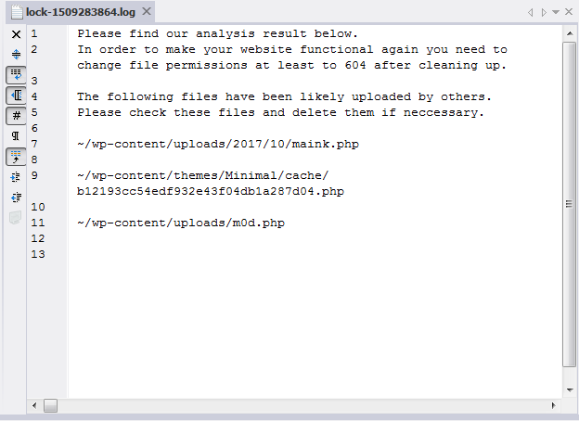
WordPress Hacking
October 29, 2017 – failed attempt
Attempted to upload malicious files & access logins
Host server quarantined three files
Notes:
Here’s another case of hacking attempt. This time on October 29, 2017, a hacker failed to upload malicious files through WordPress.
The hacker also attempted to access WP login accounts and failed.
Upon further investigation and review of the host server logs, we identified the origin of the ISP that the hacker was using.
The ISPs were located in Ukraine and Netherlands.
Site host 1and1.com was able to lock these three files which prevented the hacking attempt.

Slide 7
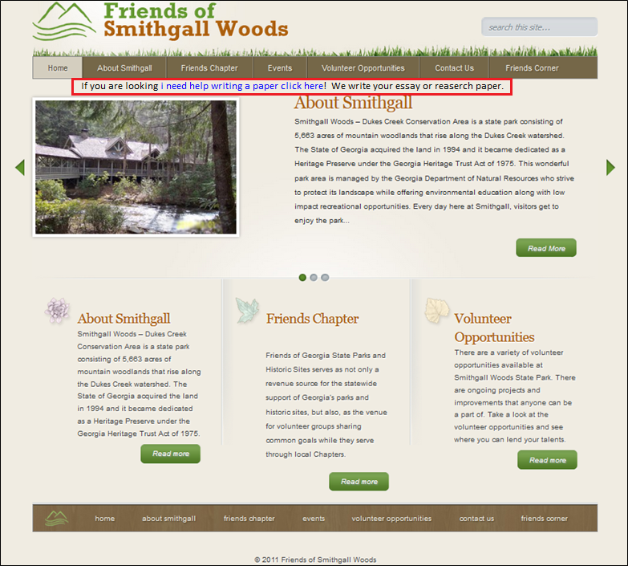
Malicious Code Injection
October 30, 2017 – successful injection
“If you are looking i need help writing a paper click here! We write your essay or reaserch paper.”
Notes:
Here’s the last case of hacking. On October 30th, a hacker was able to successfully inject a malicious code to a couple of website files.
This time it was a direct injection to the php file as you see here inside the red box.
After reviewing the host server logs, the IP address used by the hacker traced back to an ISP that was located in Mt View CA.
------------------------
Changed header.php & style.css
Mountain View, California

Slide 8
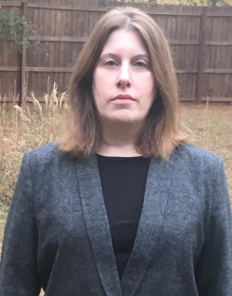


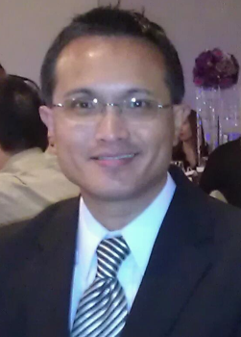

Meet the Team
Andrea Castresana
Requirements Manager Client-side Developer
Jennifer Lazo
Client-side and
Server-side Developer
Alexander Couch
UX Design Manager Server-side Developer
Clark Williams
Database Manager
Documentation Manager
Eliseo Santos
Project Manager
Test Manager
Notes:
Here’s the team that delivered a high-quality and improved website and Volunteer app to Smithgall Woods.
Andrea is our RM and CSD. She managed the requirements development and communicated the requirements execution with our client.
Jennifer oversaw the site and app development both on the client-side and server-side. She also managed the successful deployment of the site/app.
Alex is our UX Design manager and SSD. He managed the design features of the improved site/app, providing better user experience.
Clark is our DB manager and Documentation manager. He managed the development of user guides and video tutorials to ease the maintenance and update process of the site and app for the Friends Chapter admin.
And as the PM for this team, I’m glad to lead this excellent team with the right mix of expertise.

Slide 9
Project Stakeholders
Mr. Chuck Blaine
Interim President & Vice President, Friends of Smithgall Woods State Park Chapter
Mr. Art Pease
Project Liaison, Friends of Smithgall Woods State Park Chapter
Dr. Mark Huber
Project Sponsor, University of Georgia Master of Business & Technology
Ms. Anne Hughes
Secretary, Friends of Smithgall Woods State Park Chapter
Mr. Van Bareither
Treasurer, Friends of Smithgall Woods State Park Chapter

Slide 10
Project Background
Problem
Difficult to update/maintain site and Volunteer app
Outdated PHP, WordPress, themes and plugins
Degraded site and app security
Solution
Rebuild site and app using current WordPress & PHP
Continue using 1&1.com web host (instead of Bluehost)
Establish Admin Documentation & Video Tutorials
Train FSGW Reps
Notes:
Our Woodland Rangers Team was tasked to help the Friends of Smithgall Woods State Park to resolve these website concerns.
Based on our team’s assessment of the website, we determined that the existing site and Volunteer app were difficult for SGW representatives to maintain, which caused PHP, WordPress, themes and plugins to become outdated that degraded the website’s and app’s security over time.
To resolve these concerns, our team coordinated these solutions with the project sponsor and the Friends Chapter President which include..
Rebuild site and app using current WordPress & PHP
Continue using 1&1.com web host (instead of Bluehost)
Establish Admin Documentation & Video Tutorials
Train FSGW Reps
-------------------------------------------------------
Also, when our team was conducting a systems analysis of the site, we found it difficult to navigate through the existing menu structure.
Criteria for website hosting:
Code must be accessible and portable
Cost must be below $20
Site security must be include SiteLock and SSL Certificate

Slide 11
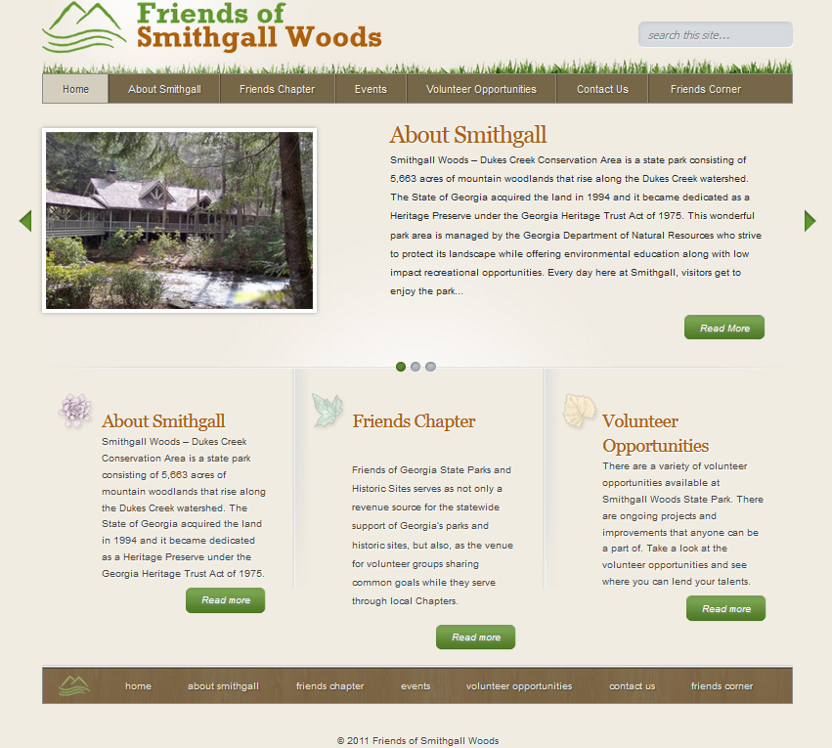
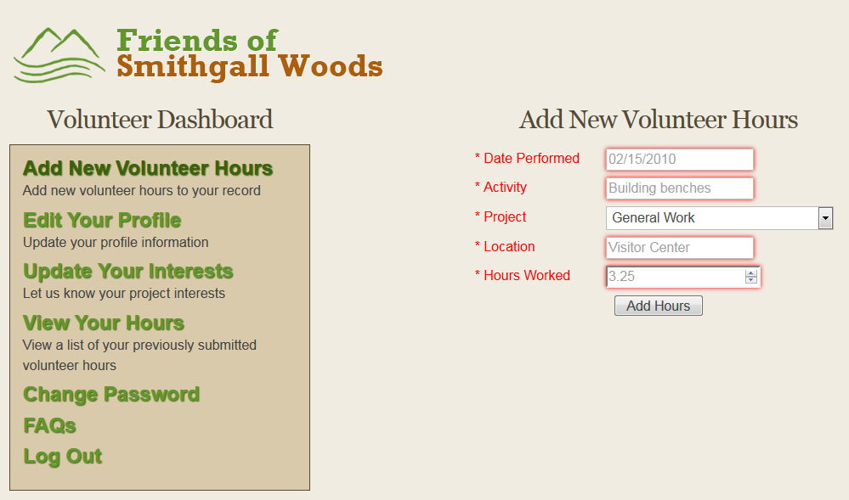
Why update the Site and App
Difficult to update page content/images
App breaks down with later versions of PHP
Critical for volunteer hours reporting to State
Notes:
Why update the Site and App
Difficult to update page content/images
App breaks down with later versions of PHP
Critical for volunteer hours reporting to State

Slide 12
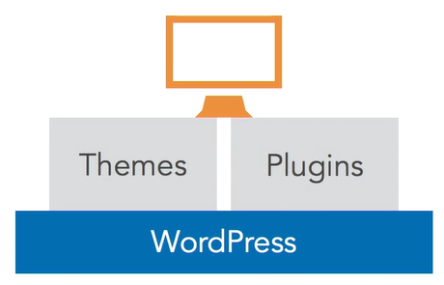
Three Viable Options for App
Option 1: Purchase yearly license (~$400) for Gravity Forms & GravityView plugins
Option 2: Use at least seven Free plugins and add-ons (Beta version)
Option 3: Rebuild existing Volunteer App as standalone with some improvements
Notes:
Good Evening Ladies and Gentlemen. Andrea just described why the Friends Chapter’s website and Volunteer app had to be rebuilt.
Next, I’d like to take a few minutes to go over how our team came up with the best solution for the Friends Chapter’s Volunteer App.
This is one of the critical phases of this project where we had to carefully translate the user requirements into the most viable solution.
While focusing on the Friends Chapter’s number 1 requirement which is ease of update and maintenance of their site and app, our team came up with three viable options for their app.
Option 1 requires a yearly subscription of about $400 for two plugins. (**Go to How WordPress Works) This solution was not implemented in this project due to budget limitations and the high risk in maintaining these two plugins.
Option 2 also uses several plugins but provided free of charge through WordPress.org from 54,000+ available Plugins. These plugins provide the functionalities in WordPress, and most of these free plugins are NOT one-size-fits-all and they use built-in (non-customizable) DB tables which makes it very difficult to set up the required features for the app.
Option 2 and Option 1 were not implemented in this project because it is too high of a risk for the Friends Chapter to implement them at this time without the right skill set/experience in their staff to maintain the app with these plugins.
In both solutions, the Volunteer app would rely on WP to run. So, when WordPress website goes down, the Volunteer app goes down as well. Since the Friends Chapter depends on their Volunteer App for timely reporting to the State, Options 1 and 2 were not implemented at this time.
However, Option 2 is available in Beta version to the Friends Chapter for future use or any future projects.
So the Friends Chapter decided to go with Option 3 which is to rebuild its existing app as standalone with the required improvements. We set it up as standalone so that the app is not dependent on WordPress to run. It will continue to run even if the WP site is down. Option 3 significantly minimizes the risk of losing any Volunteer hours data.

Slide 13
Benefits to FSGW
Ease of update and maintenance
Simplified page content/image update process
Monthly maintenance takes ~<5 minutes
Time savings and timely reporting to State
Notes:
With the chosen solution to rebuild the website in WordPress and rebuild the Volunteer app in PHP as standalone, it will provide the Friends Chapter the following benefits:
Our team focused our efforts on meeting the Friends Chapter’s number 1 requirement which is ease of update and maintenance of the site and app.
The tool we implemented simplifies the page content/image update process
With Easy-to-follow video tutorials and user guides, it makes it even easier to maintain both the website and app.
Reduces processing time from user input of volunteer hours to generating quarterly reports which ensures timely reporting to the State

Slide 14
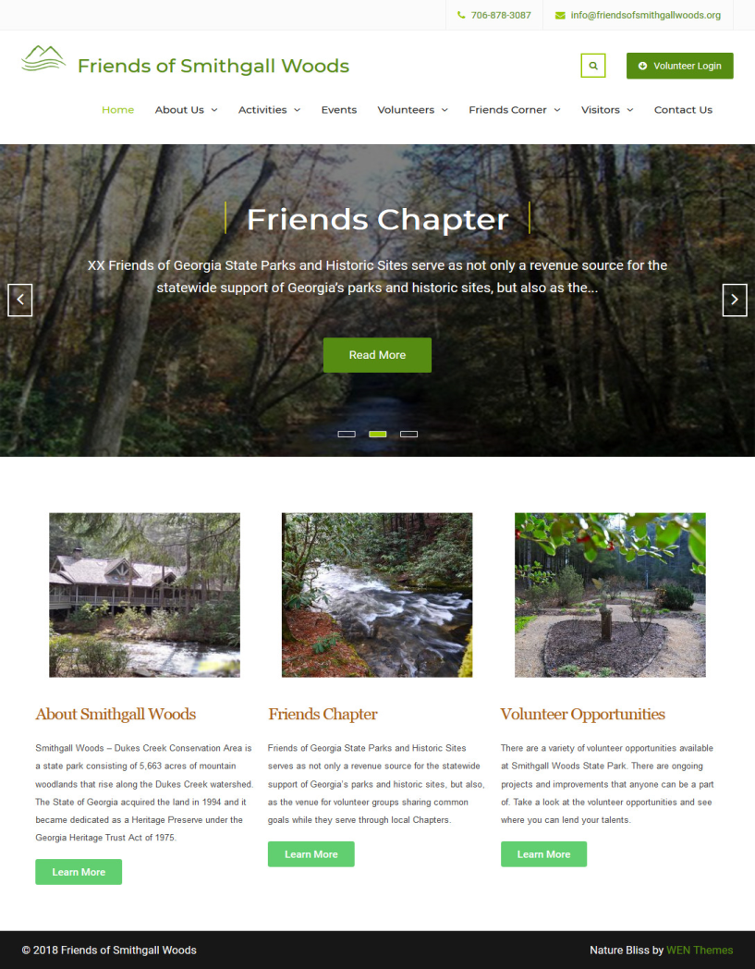
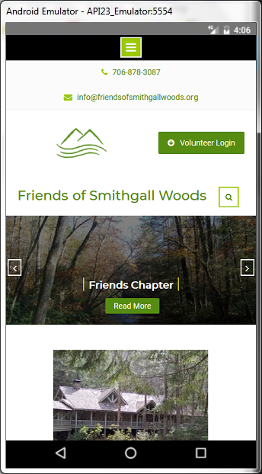
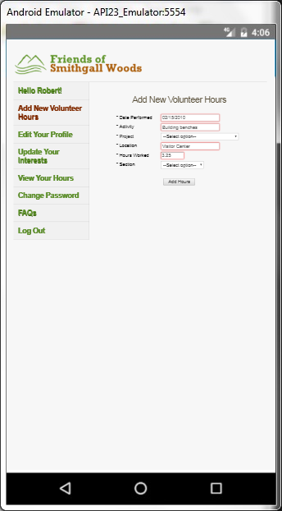
Improved Site & App
User-friendly navigation menu
Very responsive on mobile devices
App’s upgraded PHP/MySQLi functions
Notes:
Improved Site & App
In addition to the list of benefits described in the previous slide,
This improved website also provides users and visitors a user-friendly navigation menu
Which makes it easier to search for information in the site
It also makes it very responsive on mobile devices
With the App’s upgraded PHP and MySQLi functions, it has improved the app’s security, protecting it from future hacking and malicious code injections.

Slide 15

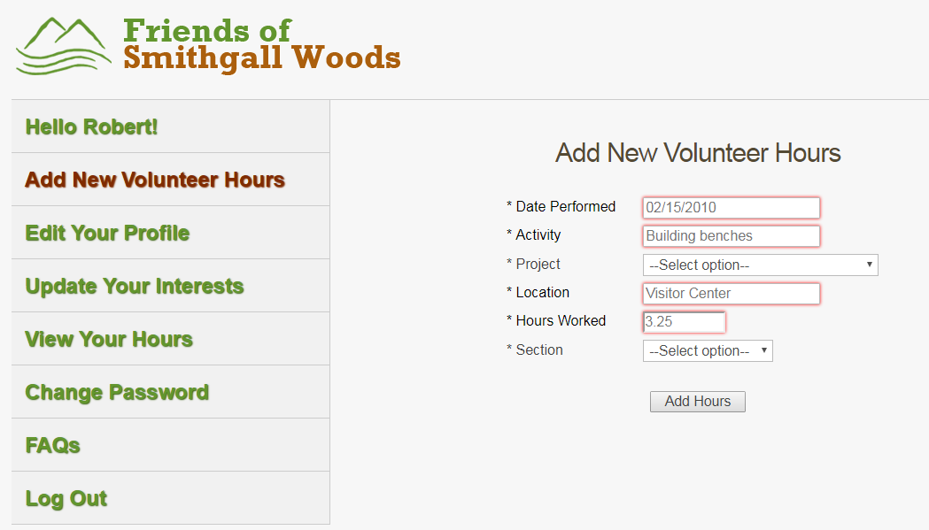
Site & App Demo – Live Version
Improved Site and Volunteer App
https://www.friendsofsmithgallwoods.org
https://www.friendsofsmithgallwoods.org/volunteer
Notes:
These are the web addresses for the site and app.
The site runs inside WordPress, and the Volunteer App is standalone that is developed in PHP and does not require WordPress to run.
Now, we’ll do a quick demo of the site:
The slider is linked to three featured images that can be easily set in the back-end of WordPress.
The Home page’s Widget Area can be expanded to include the Blog, Team, and Services sections.
All Access Trail is a new page that we added to the site.
The Events page contains images and toggle feature that is used by SGW to post recurring park events info.
Each page uses randomized header images with the page title displayed on the image.
This is the photo gallery page with the slideshow feature.
The Directions page contain an interactive map of SGW.
We moved the Volunteer Login link one level up for easy access to the Volunteer App.
Volunteer App:
The improvements we made to the app includes the addition of the Section field to track hours for SGW & Hardman Farm (demo the drop-down window)
We also added the Left Sidebar menu for mobile-friendly
We added the Login name to show who’s currently logged in
This is the View Hours page
We also changed the background color to make it more neutral
Most importantly, we updated the code to use the improved version of the MySQL that allows the app to run in later versions of PHP since MySQL in PHP was deprecated in 2012.

Slide 16
Test Plan
Website Test Cases
Case #1: Site Navigation Menu and Hyperlinks
Case #2: Drop-down Windows in Events Page
Case #3: Tabs Widget in Roads & Trails Page
Case #4: Photo Gallery Slideshow
App Test Cases
Case #1: App Navigation Menu and Hyperlinks
Case #2: Registration and Login Functionalities
Case #3: Create Record
Case #4: Read Record
Case #5: Update Record
Case #6: Delete Record
Notes:
After deploying the site and app to the host server, our team ran several test cases to make sure that we’re delivering a high quality and very reliable website and app to the Friends Chapter.
We successfully completed 4 test cases for the site
and, 6 test cases for the Volunteer app
So at the end of testing, our team determined that the website and app are healthy with all functionalities working well.

Slide 17
Documentation
User Guides
Managing SGW Website
Updating WordPress and Plugins
Managing Projects Table
Managing Emails
Volunteer Hour Reports
Managing phpMyAdmin DB Tables
Video Tutorials
Managing SGW Website
Updating WordPress and Plugins
Managing Projects Table
Managing Emails
Notes:
This is the list of User Guides and Video Tutorials that we’re also providing to the Friends Chapter in addition to the training session we conducted with them last Saturday.
The guide and tutorial for Managing the Website will be very beneficial to the Friends Chapter Administrator

Slide 18
Challenges
Team’s little to no experience on WP & PHP
Determining best solution for site and app
Search for compatible plugins (from 54,000+)
Limited availability of client and team
Notes:
In this project, our team encountered these challenges and worked through them.
With limited PHP & WP experience in our team, it was quite difficult for our team to translate the user requirements into an acceptable solution. We had to learn the necessary toolset using the tutorials in Lynda.com to overcome this issue.
Investigating those 3 viable solutions was quite a challenge. To integrate the Volunteer App in WordPress, we had to find the most suitable plugins from thousands of free plugins. These plugins provided the needed functionalities in WordPress, and most of these free plugins were NOT one-size-fits-all which made it very difficult to set up the Create, Read, Update & Delete functions for this Alternate Volunteer app.
Scheduling meetings was a challenge because of limited availability of our team members and the client
Caused some delays in requirements analysis

Slide 19









Tools
Notes:
This is the list of tools that our team used to develop the website and Volunteer app.
We used the WampServer and phpMyAdmin tools for local development and testing of the site and app.

Slide 20
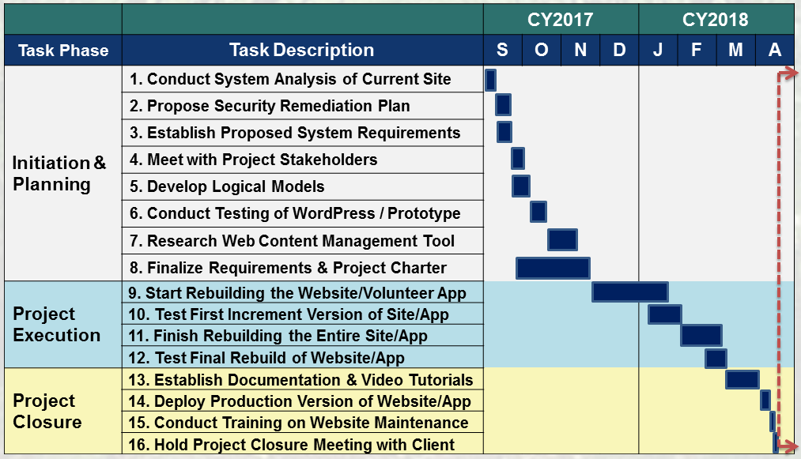
Project Schedule
Notes:
Here’s a list of all project tasks that we’ve accomplished for this project.
We had our training session and closure meeting with the Friends Chapter staff this past Saturday.
We’ve also finished putting together all user guides and video tutorials, and we’ll be providing them to our client shortly.

Slide 21
Conclusion
Improved FSGW Website & Volunteer App
Easily maintain the site and app, improving security
Efficiently track 250+ Friends Chapter members & 5,000+ volunteer hour records
Securely manage and store volunteer data
Significantly reduce time to collect and process data
Ensures timely reporting of volunteer hrs to the State
Notes:
In closing, the Friends Chapter can now enjoy these benefits from their improved website and Volunteer app.
They can now easily maintain the site and app which improves their security to protect them from future hacking and malicious attacks.
Their improved Volunteer app will now allow them to efficiently track over 250 Friends Chapter members and over 5K of volunteer hour records.
They can securely manage their volunteer data
Also with the improved Volunteer app, they can see reduction of time to collect and process volunteer data which ensures accurate and timely reporting of their volunteer hours each quarter to the State that provides their revenue.
Before I open it up for questions, I’d like to thank Mr. Art Pease of the Friends Chapter and Dr. Huber our Project Sponsor for working with us on this project.
I also would like to thank our professors for their guidance to help us succeed in this Master’s program.
Thank you also to my fellow students for an awesome class.
To our visitors, thank you for joining us tonight to listen to our presentation.

Slide 22
Questions

Slide 23
BACKUPS

Slide 24
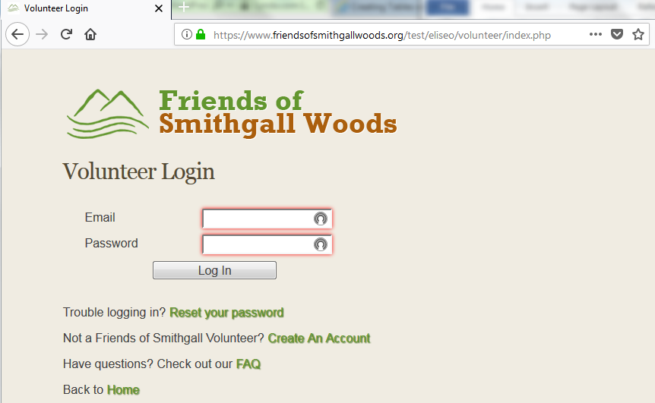
Existing Volunteer App
Standalone app linked from WP site

Slide 25
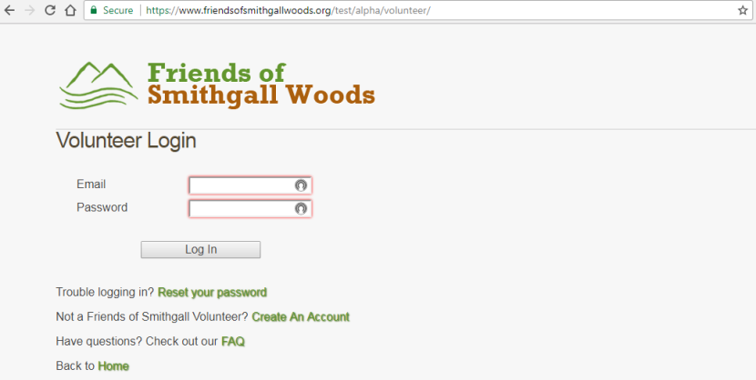
Improved Volunteer App
Added Left Sidebar Menu
Added Login Name in each page
Added Section Field for Hardman Farm & SGW
Updated app from PHP 5.6 to 7.2
Notes:
Our team has been working on meeting the user requirements for mobile capability of the site and app.
Since the client had chosen for our team to rebuild the existing app as stand-alone, we’ve made the following improvements to it:
We added the Login Name in each page of the app
We created another field that identifies volunteer hours for Hardman Farm
We also updated the app to run on PHP7.X and future PHP updates by resolving the obsolete MySQL functions on these later versions of PHP.
And we needed to move the menu from the top bar to the left sidebar to make it mobile-friendly. The top menu bar did not work well with mobile devices.

Slide 26
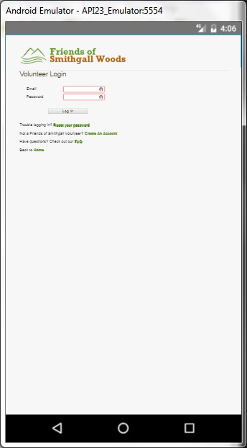
App’s Mobile-friendly Design
Notes:
This is a screenshot of the Login page in a mobile-friendly view.

Slide 27
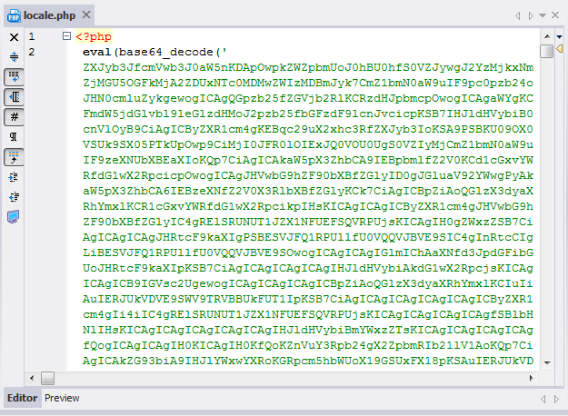
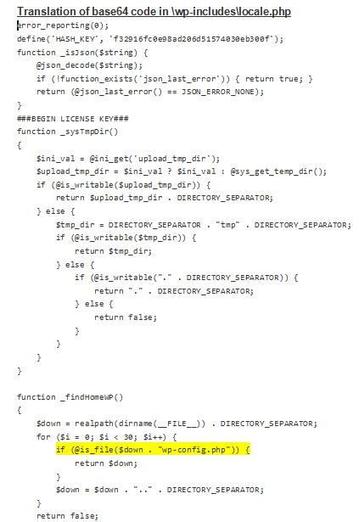
Malicious Code Injection
~June 6, 2016 – successful hacking
eval (base64_decode (‘…….’));
Notes:
The green letters and numbers that you see inside the parenthesis are decoded with the eval function. When the function is run, it executes this translated code that you see on the right…..it’s about 28 pages long.
wp-config.php – This is also one of the highly targeted files by the hackers.

Slide 28
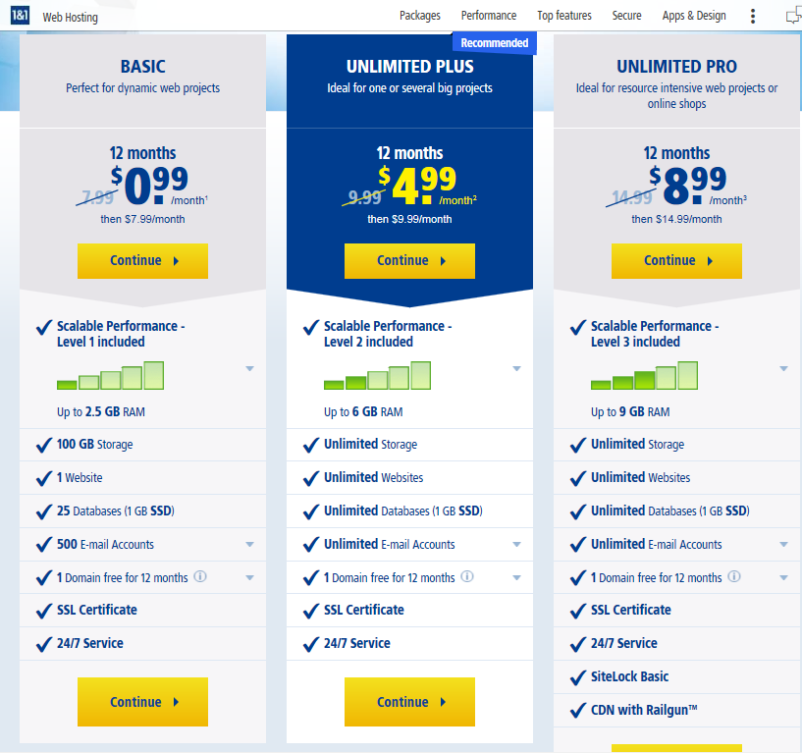
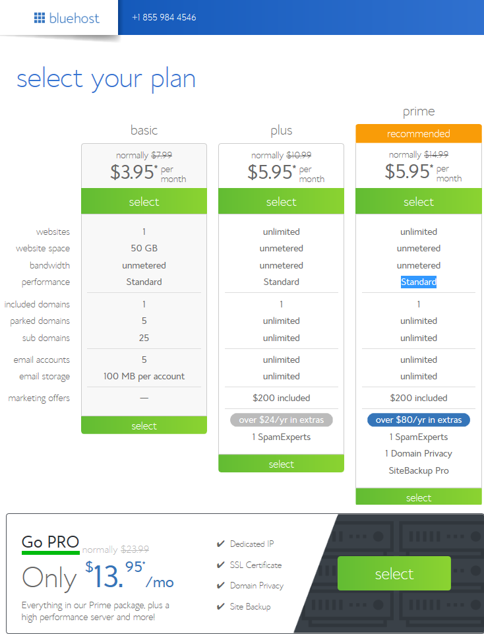
Web Hosting Cost Comparison
1and1.com - $8.99/mo ($14.99 after 1yr)
Bluehost - $13.95/mo ($23.99 after 1yr)

Slide 29
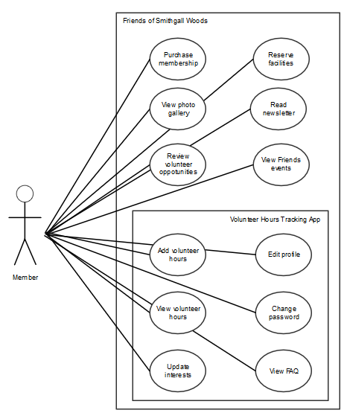
Friends Volunteer Use Cases
Notes:
The person who performs volunteer work for Smithgall Woods (SGW) is a Friends Chapter member. All other volunteers that are NOT Friends Chapter members are tracked through the Georgia State Park website.

Slide 30
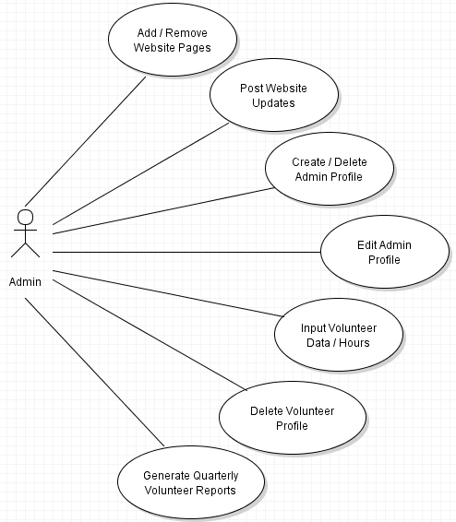
Admin Use Cases
Notes:
The last bubble “Placeholder for Volunteer Use Cases” is only used in this diagram to indicate some use cases from the Volunteer actor.

Slide 31
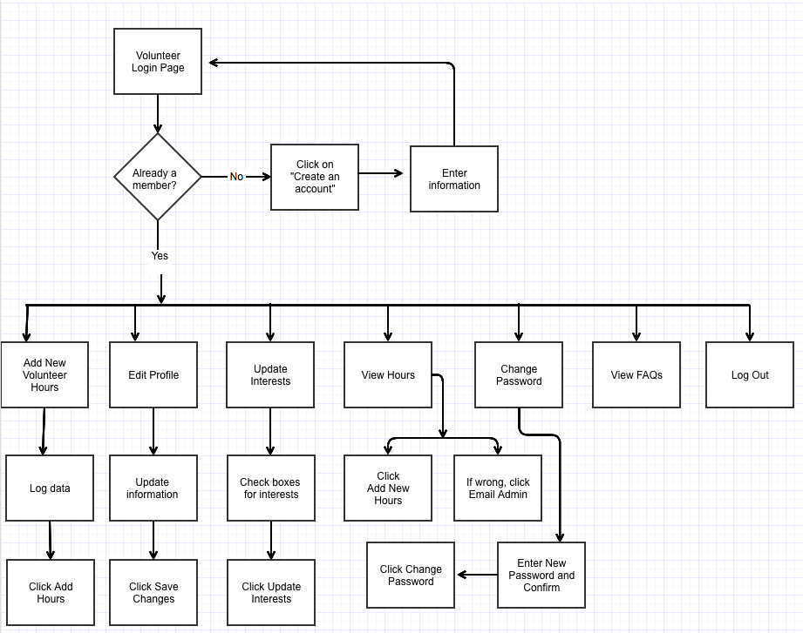
Friends Volunteer Workflow
Notes:
This Friends Volunteer workflow describes the existing Friends Volunteer Log process.

Slide 32
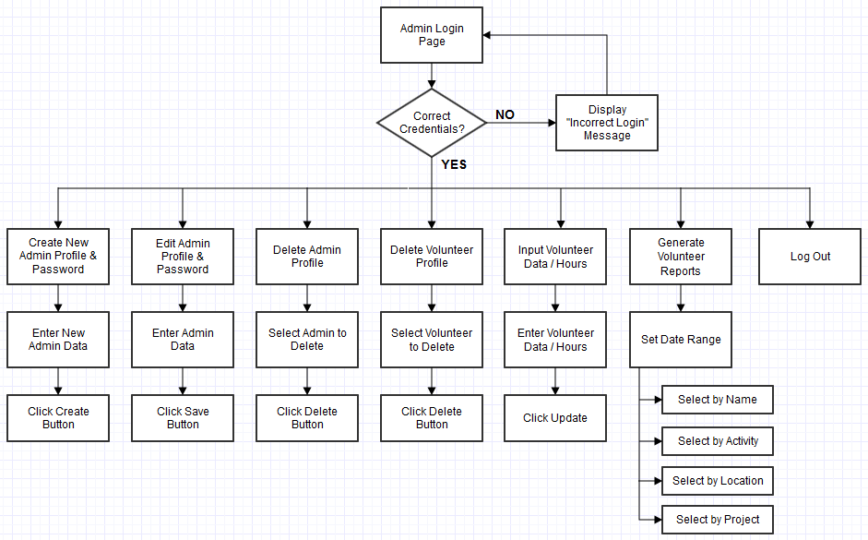
Admin Workflow
Notes:
This Admin Workflow is based on the proposed user/system requirements. A separate login page for Admin will be developed, and an Admin/Password pair will be set up initially in the MySQL “admin_login” table. Then, the Admin must log in first to create user accounts with admin privileges.

Slide 33
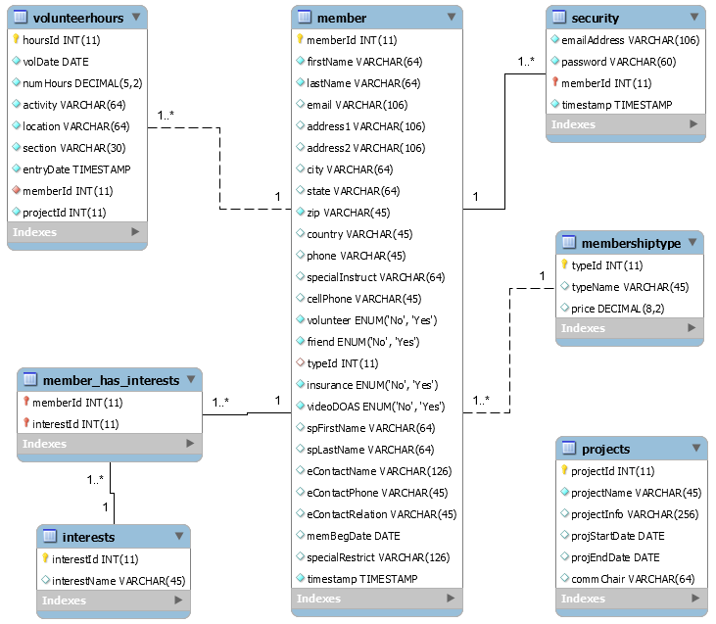
Volunteer App’s Data Model
Notes:
The current app’s DB include seven tables. Six tables are related with one-to-many relationship.
The red highlight shows the added Section Field in the volunteerhours table.
A standard WordPress site uses about 12 DB tables to store page and post contents.

Slide 34
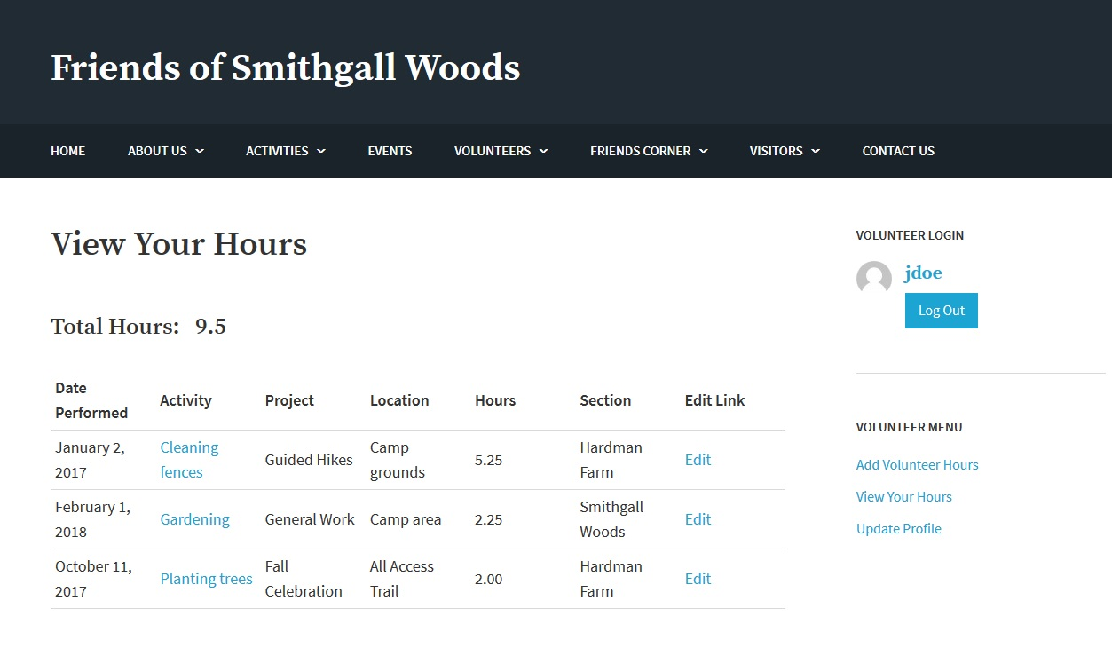
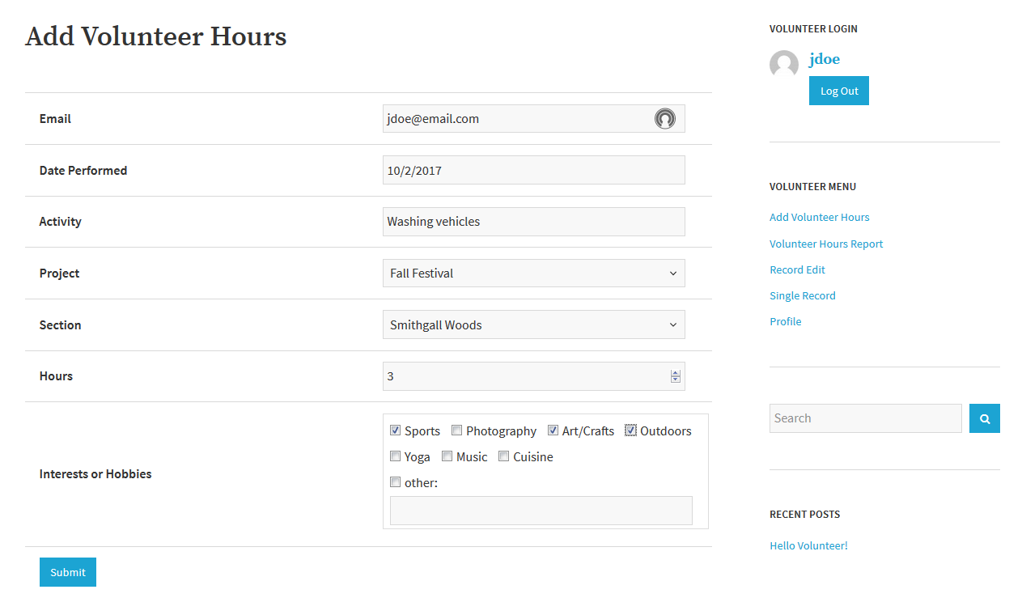
Option 2: Alternate Solution
Website & App in WP – Beta Version
Available for future use
Go back
Notes:
This Alternate Solution was not implemented for the Friends Chapter. In this solution, the Volunteer app relies on WP to run. So, when WordPress site goes down, the Volunteer app goes down as well.
So, our team determined that this Option is just too risky for the Friends Chapter to implement at this time without the right skill set/experience in their staff to maintain the app.
However, this solution is available to the Friends Chapter for future use or any future projects.

Slide 35
How WordPress Works
WordPress Core
Custom Appearance (Themes)
Custom Features & Functionality (Plugins)
Go back
Notes:
One of the great things about WordPress is the ability for developers to extend the core functionality of the code base to do just about anything you can think of. So we've got WordPress Core, and that's a stable code base that you can use as a platform to build your site. If you need to add custom features or functionality, instead of directly editing WordPress Core, you use plugins.
WordPress also gives us a way to change the appearance of a website, and that's done through themes. So we've got themes and plugins, where themes control the look of a site and plugins control any site-specific functionality that's needed in addition to WordPress Core.
In the next slide, I’ll briefly describe three viable solutions for the App that our team provided to SGW. Just to recap, SGW is using this app to track Friends Chapter members’ volunteer hours which are reported to the state, and SGW earns revenue for those hours.

